Slide 1
FOREST AND WILD LIFE RESOURCES.
Learning Objectives. - To analyze the different types of forest and conservation measures introduced by the government

Slide 2

◻ The variety of Flora and Fauna in a given geographical area is called biodiversity of that area.
◻ Biodiversity refers to the variety of life. It is seen in the number of species in an ecosystem or on the entire Earth.

Slide 3
INDIA IS RICH IN BIODIVERSITY.
INDIA HAS 8% OF THE TOTAL NUMBER OF SPECIES IN THE WORLD.
81,000 SPECIES OF FAUNA.
47000 SPECIES OF FLORA.
15000 FLOWERING SPECIES ARE ENDEMIC TO INDIA.

Slide 4
FLORA AND FAUNA
◻ Flora is a collective term used to denote plants of a particular region. The whole plant kingdom is represented by this name. The term flora in Latin means “Goddess of the flower”
◻The term Fauna is used to denote species of animals of a particular region or period.

Slide 5
THREATS TO BIODIVERSITY.
10% wild flora and 20% mammals are on the threatened list.
79 species of mammals, 44 of birds, 15 of reptiles, and 3 of amphibians are threatened.
1500 plant species are endangered.
The forest and tree cover is only in 78.92 million hectares .
The share of forest land is only 24% of the total area.

Slide 6
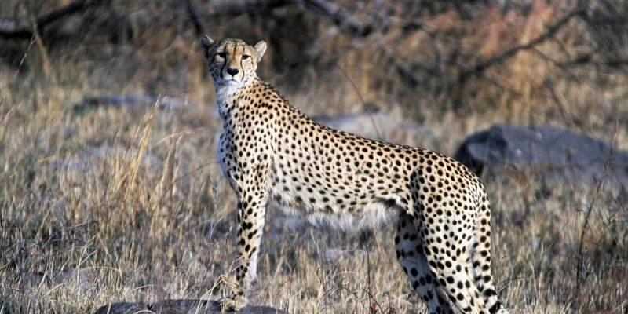
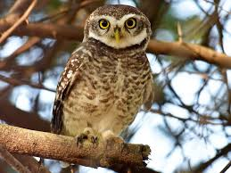
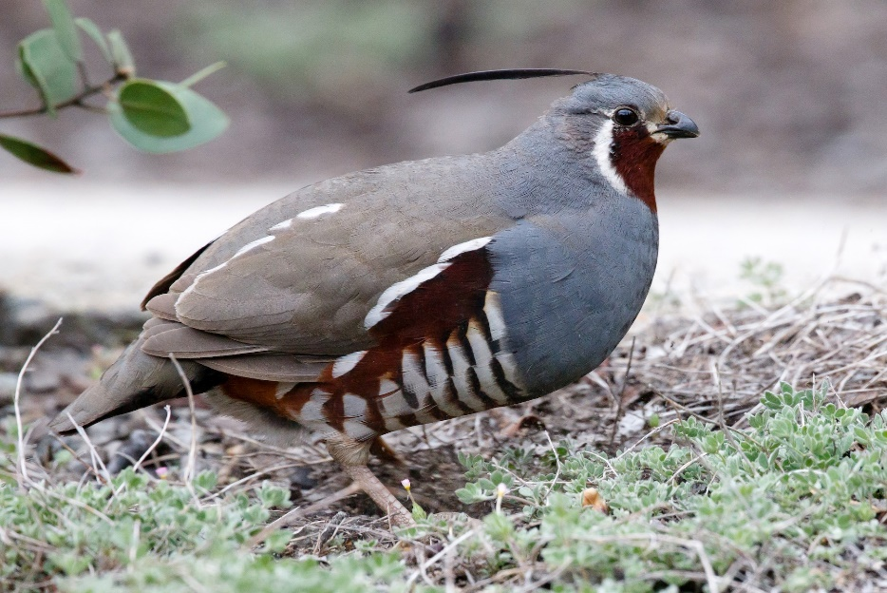
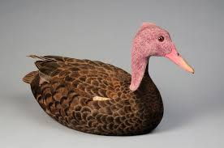
SPECIES CATEGORISED AS CRITICAL.
CHEETAH.
FOREST SOTTED OWLET.
MOUNTAIN QUAIL.
PINK HEADED DUCK.

Slide 7

A forest is a large area of land covered with trees or other woody vegetation. Forests are the dominant terrestrial ecosystem of Earth, and are distributed across the globe.

Slide 8
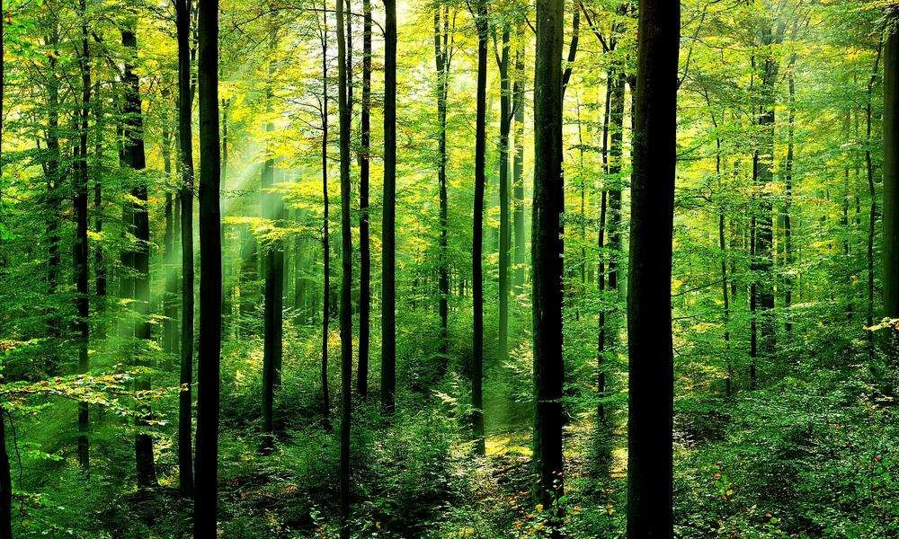

Slide 9






Tropical Evergreen Forests.
Tropical Deciduous Forests.
Tropical Thorn Forests and Scrubs. Montane Forests .
Mangrove Forests.

Slide 10

◻ The dimensions of deforestation in India are staggering. The forest cover in the country is estimated at 78.29 million hectare, which is 23.81% of the total geographical area.
◻ According to the state of Forest Report (2011), the dense forest cover has increased by 10,098 sq. km since 1997. However, this apparent increase in the forest cover is due to plantation by different agencies.

Slide 11
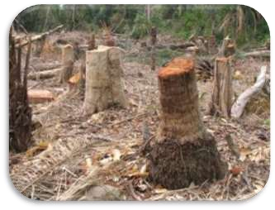
◻ The state of Forest Report does not differentiate between natural forests and plantations.
Therefore, these reports fail to deliver accurate information about actual loss of natural forests.

Slide 12

Wildlife means an area where undomesticated animals living in the wild including those hunted for food, sport or profit. Wildlife can be found in all ecosystems.

Slide 13
Forests act as watershed.
They are habitat for wildlife.
They give us economic benefits.
They help in climate control.
Wildlife help in balancing ecosystem.
Maintain food chains.
They also act as a means of recreation.

Slide 14
CLASSIFICATION OF SPECIES
NORMAL SPECIES
ENDANGERED SPECIES
VULNERABLE SPECIES
RARE SPECIES
ENDEMIC SPECIES
EXTINCT SPECIES

Slide 15

Species whose population levels are considered to be normal for their survival, such as cattle, Sal, pine, rodents, etc.

Slide 16
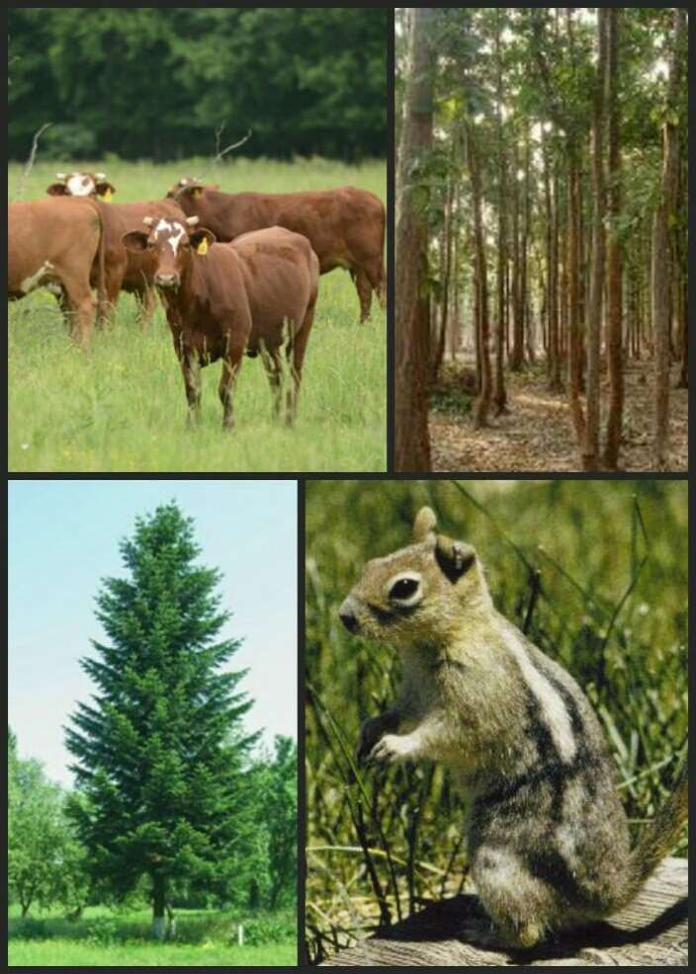

Slide 17

These are the species which are in danger of extinction. Survival of such species is difficult if the negative factors that have led to a decline in their population continue to operate. Examples : black buck, Indian wild ass, crocodile, lion tailed macaque
`

Slide 18
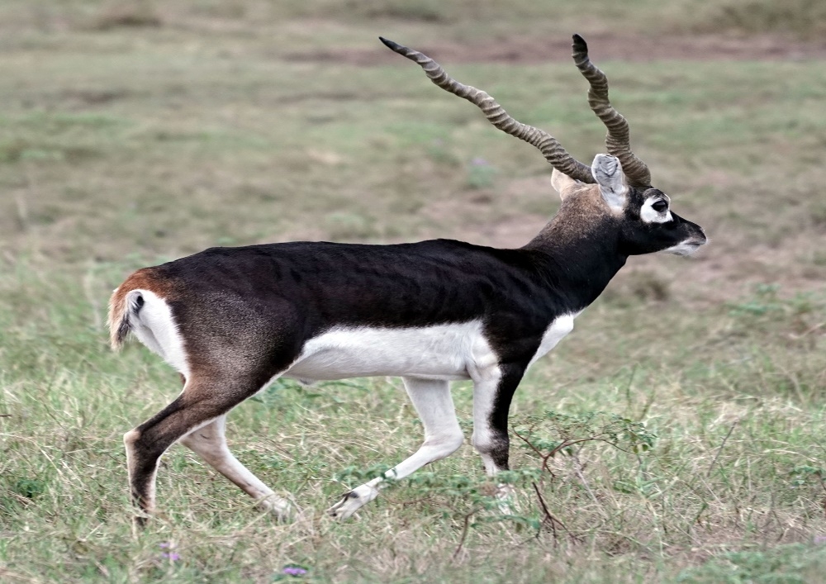
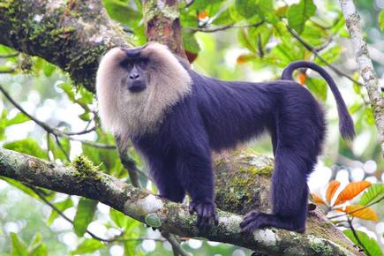
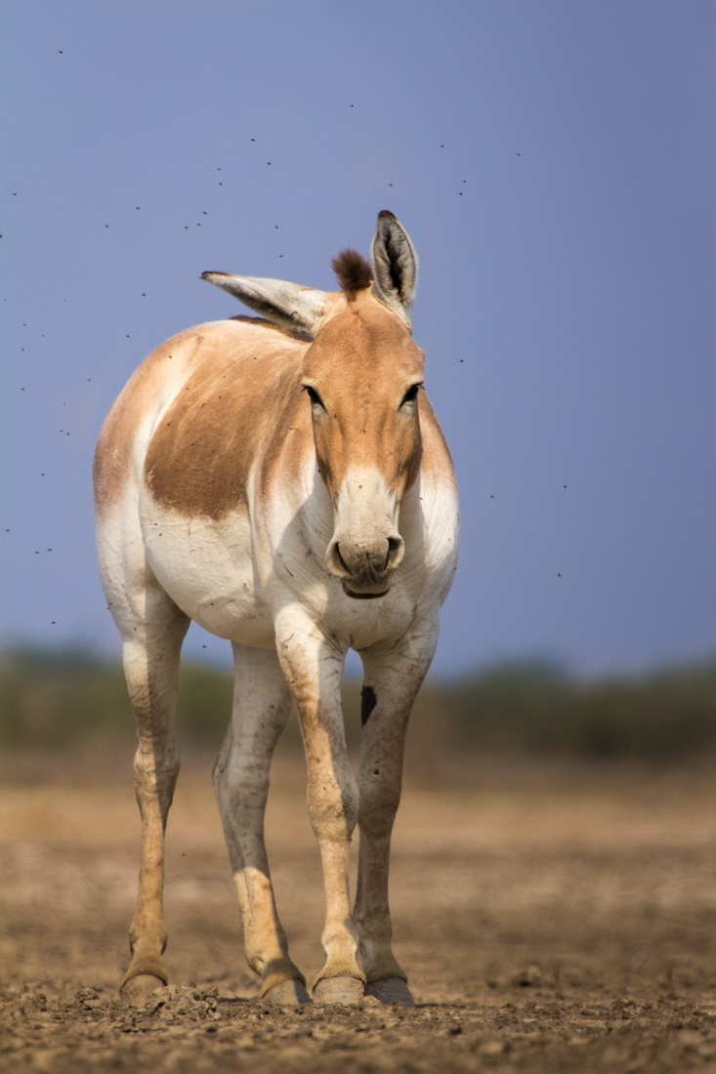
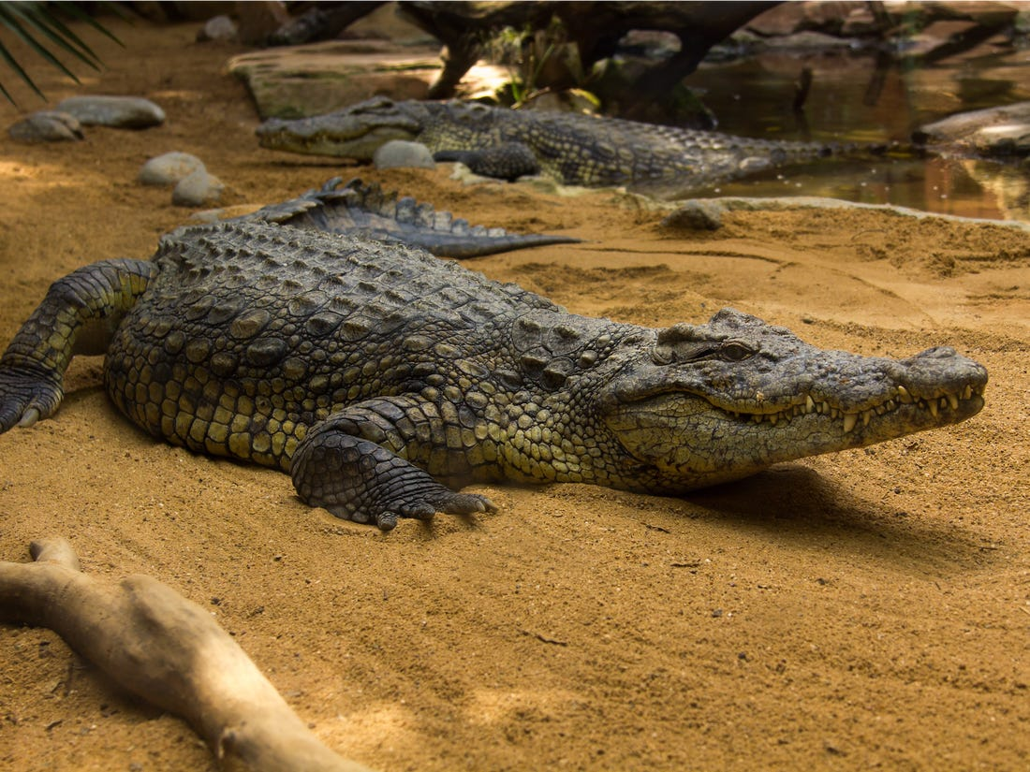
BLACK BUCK
LION TAILED MACAQUE
INDIAN WILD ASS
CROCODILE

Slide 19

These are species whose population has declined to levels from where it is likely to move into the endangered category in the near future if the negative factors continue to operate. The examples of such species are blue sheep, Asiatic elephant, Gangetic dolphin.

Slide 20
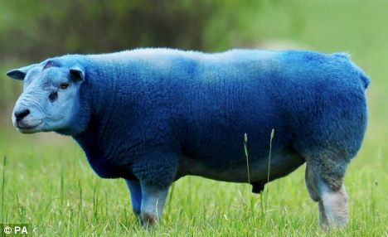
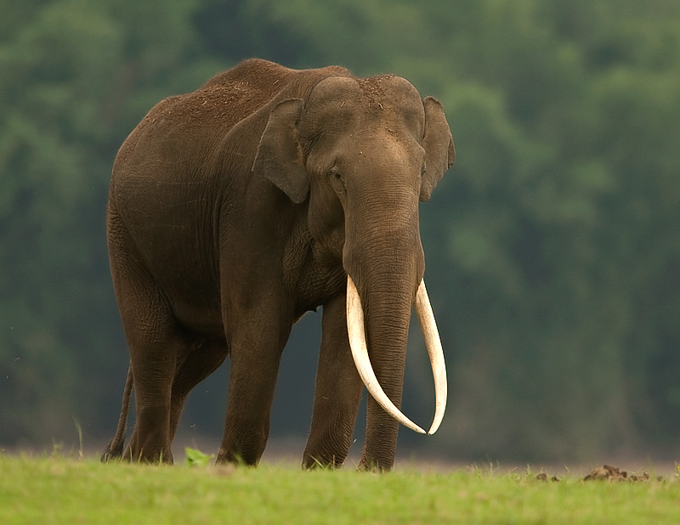
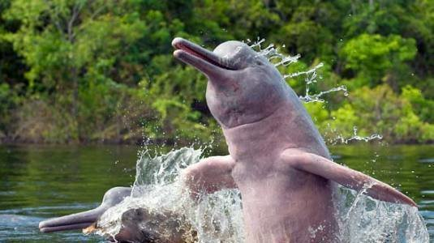
BLUE SHEEP
ASIATIC ELEPHANT
GANGETIC DOLPHIN

Slide 21

Species with small population may move into the endangered or vulnerable category if the negative factors affecting them continue to operate. The examples of such species are the Himalayan Brown bear, wild Asiatic buffalo, desert fox, hornbill etc..

Slide 22
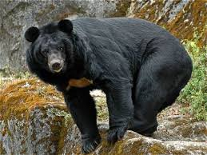
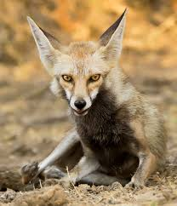
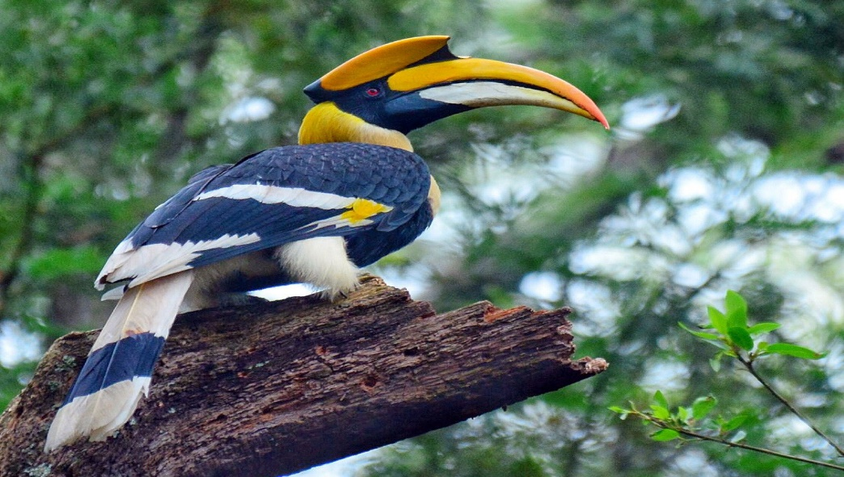
HIMALAYAN BLACK BEAR
WILD ASIATIC BUFFALO
DESERT FOX
HORNBILL

Slide 23

These are species which are only found in some particular areas usually isolated by natural or geographical barriers. Examples of such species are the Andaman teal, Nicobar pigeon, Andaman wild pig, mithun in Arunachal Pradesh.

Slide 24
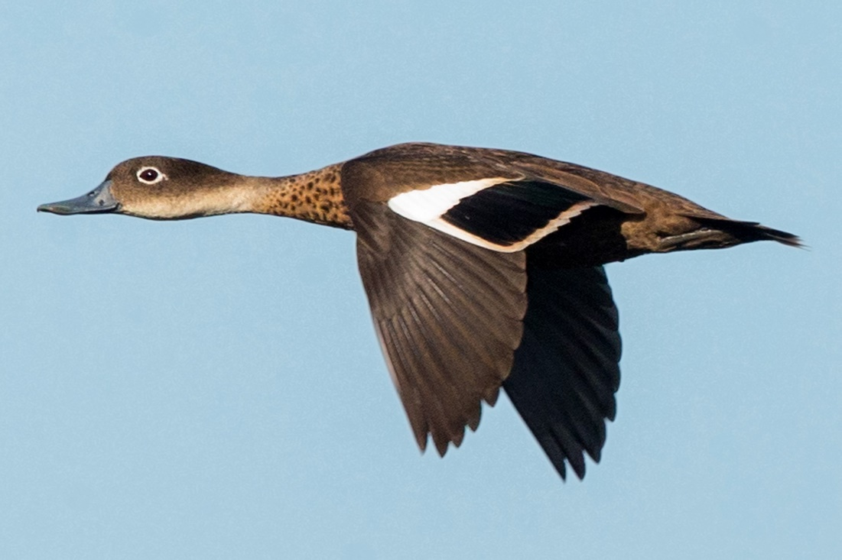
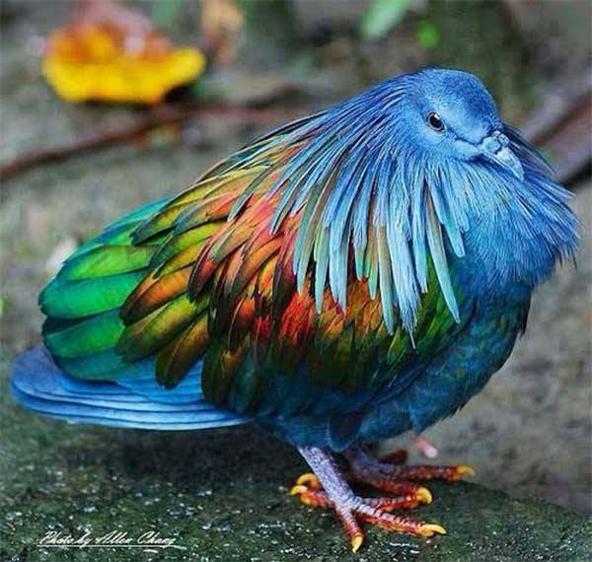
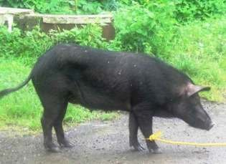
ANDAMAN TEAL
NICOBAR PIGEON
ANDAMAN WILD PIG
MITHUN-ARUNACHAL PRADESH

Slide 25

These are species which are not found after searches of known or likely areas where they may occur. A species may be extinct from a local area, region, country, continent or the entire Earth. Examples of such species are Asiatic cheetah, pink-head duck.

Slide 26
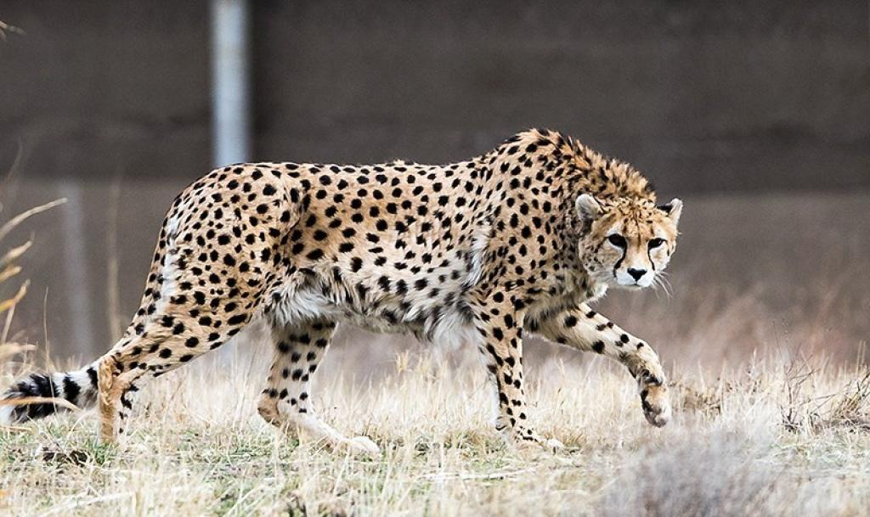
ASIATIC CHEETAH
PINK HEADED DUCK

Slide 27





Normal Species
Endangered Species
Vulnerable
Species
Rare Species
Endemic Species
Extinct Species

Slide 28
FACTORS RESPONSIBLE FOR DEPLETION OF THE FLORA AND FAUNA
1. Policies followed during the British period.
A) Expansion of railways
B) Agriculture
C) Commercial and Scientific forestry
D) Mining
Enrichment Plantation

Slide 29
DEVELOPMENTAL ACTIVITIES
A) River valley Projects
B) Mining activities
C) Grazing and fuel wood collection
D) hunting and poaching
E) over-exploitation
F) environmental pollution
G) poisoning and forest fires

Slide 30
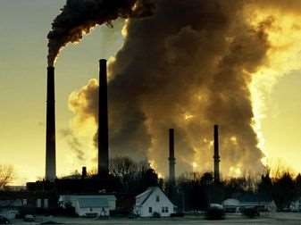
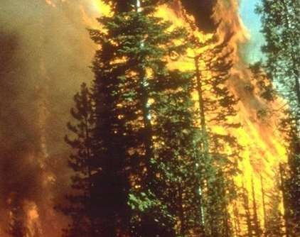
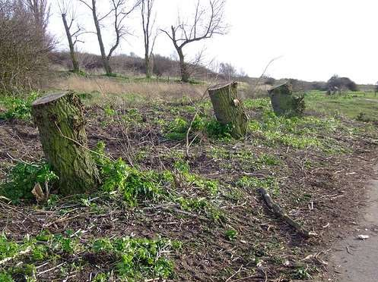
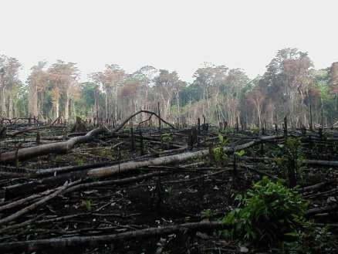

Slide 31
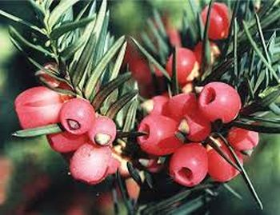
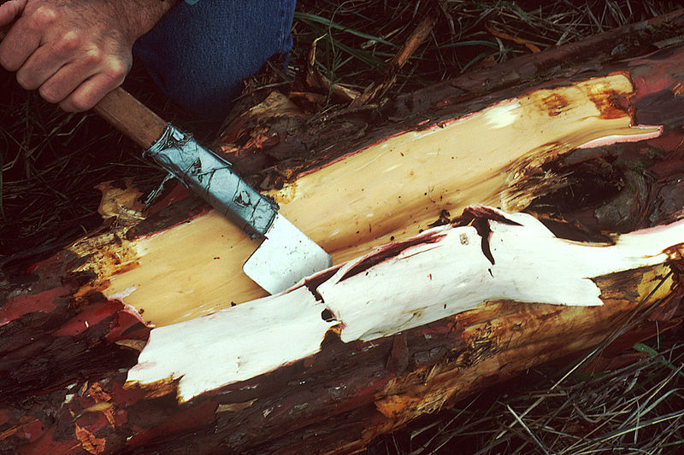
Himalayan Yew
Found in Himachal Pradesh and Arunachal Pradesh.
Taxol, a chemical compound is extracrted.
Anti-cancer medicine
It id under threat due to over exploitation.

Slide 32
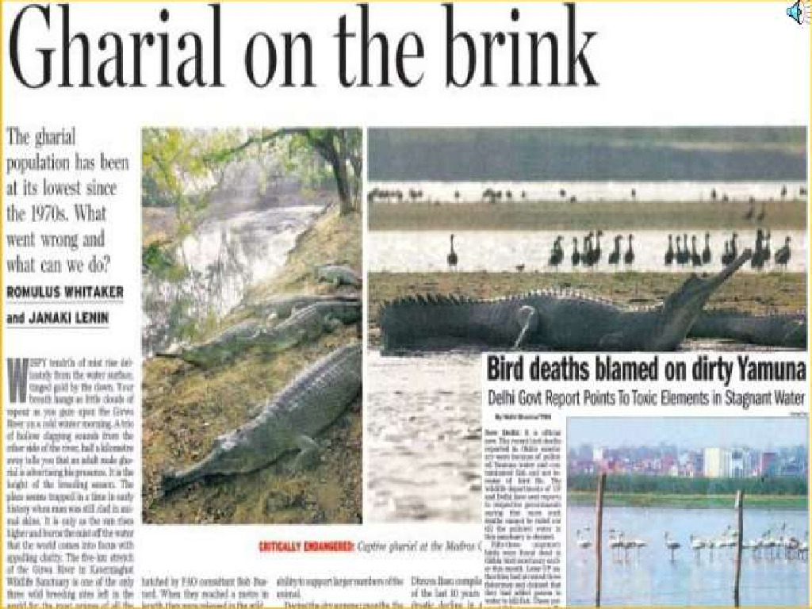

Slide 33

◻ Maintaining ecological balance for supporting life.
◻ Preserving different kinds of species (biodiversity) .
◻ Preserving economically important plants and animals.
◻ Fuel, fodder and domestic needs of the population
◻ Needs of village, small scale and large scale industries.

Slide 34
Loss of cultural diversity
1. Marginalised and impoverished many forest communities
2. Impact on women—serious health problems
3. Drought or deforestation induced floods.
4. Poors arer affected most.

Slide 35
CONSERVATION OF FOREST AND WILDLIFE
1. Indian wildlife (Protection ) Act1972.
2. List of protected species was published
3. Banned hunting and restricted trade in wildlife.
4. Established wildlife sanctuaries and national parks.
5. Projects for protecting specific animals.

Slide 36

Even if we want to conserve our vast forest and wildlife resources, it is rather difficult to manage, control and regulate them. In India much of its forest and wildlife resources are either owned or managed by the government through the forest department or other government departments.
These are classified under the following categories:

Slide 37
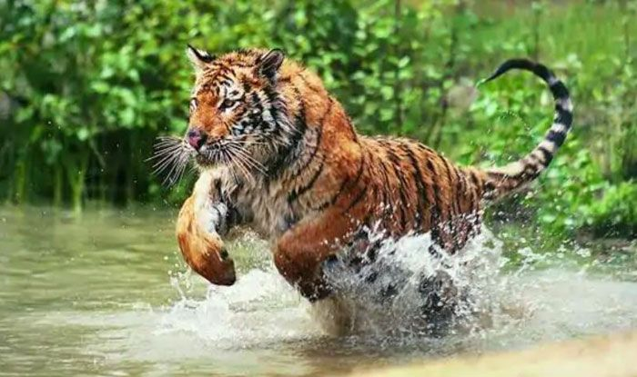
PROJECT TIGER

Slide 38

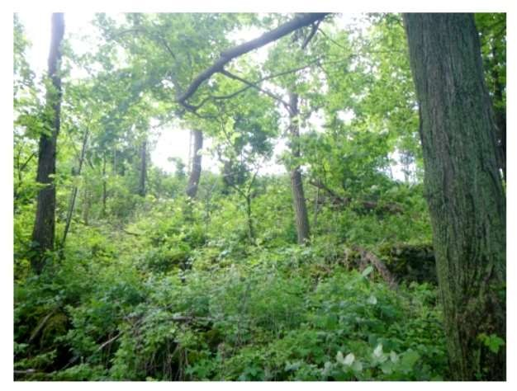
1. Reserved Forests
More than half of the total forest land has been declared Reserved Forests. Reserved forests are regarded as the most valuable as far as the conservation of forest and wildlife resources are concerned.

Slide 39

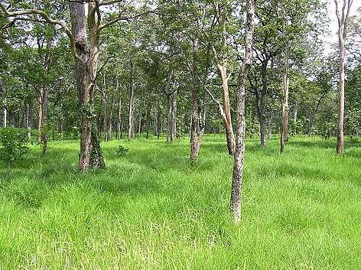
2. Protected Forests
Almost one-third of the total forest area is Protected Forest, as
declared by the Forest Department. This forest land are protected from any further depletion.

Slide 40

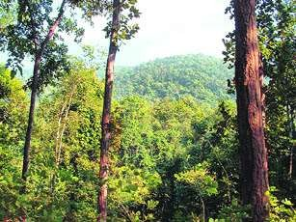
3. Unclassed Forests
These are other
and
forests
wetlands belonging to both government and private individuals and communities.

Slide 41
◻ Reserved and protected forests are also known as Permanent forest estates.
◻ Reserved and protected forests are maintained for the purpose of producing timber and other forest product, and for protective reasons.
◻ Madhya Pradesh ha the largest area under permanent forests, constituting 75% of its total forest cover.
◻ All northern states and parts of Gujarat have a
very high percentage unclassed forests
of their forests as
managed by local
communities.

Slide 42


Slide 43
◻ Regulated and Planned Cutting of Trees
◻ Control over Forest Fire
◻ Reforestation and Afforestation
◻ Check over Forest Clearance for Agricultural and Habitation Purposes
◻ Proper Utilization Products
◻ Forest Management
of Forest and Forests

Slide 44


Forest conservation act, 1980
The Forest Conservation Act 1980 was enacted to help conserve the country's forests. It strictly restricts and regulates the de-reservation of forests or use of forest land for non-forest purposes without the prior approval of Central Government. To this end the Act lays down the pre-requisites for the diversion of forest land for non-forest purposes.

Slide 45
◻ Fourteen biosphere reserves have been set up in the country.
◻ Financial and technical assistance is provided to many botanical gardens by government since 1992.
◻ Project tiger, Project Rhino, Project Great Indian Bustard and many other eco- developmental projects have been introduced.

Slide 46
◻ In Sariska Tiger Reserve, Rajasthan, the villagers have fought against mining by citing the wildlife protection act.
◻ The Chipko movement has successfully resisted deforestation.
◻ The rise of Farmers and citizen’s groups like the Beej Bachao Andolan in Tehri and Navdanya.

Slide 47
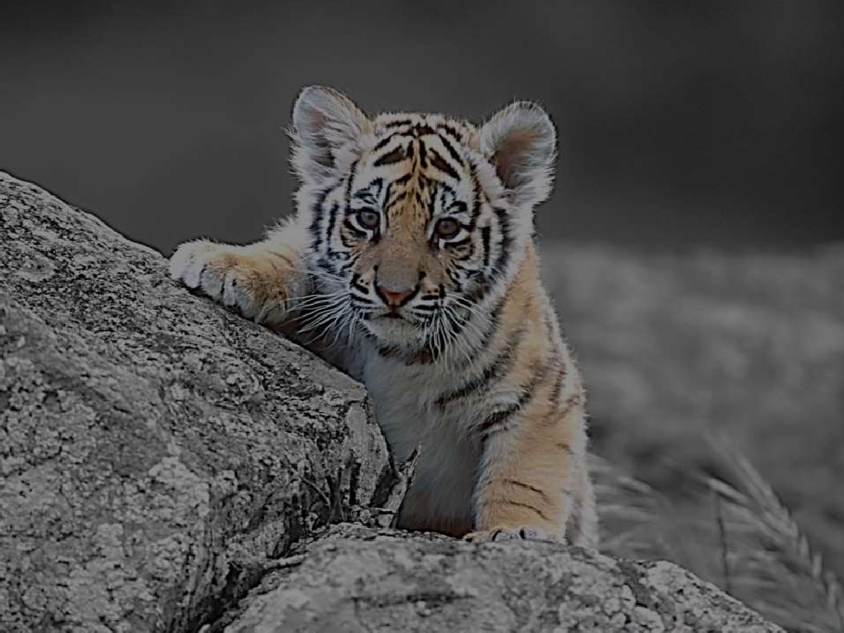

“ Project Tiger “, one of the well- publicized wildlife campaigns in the world, was launched in 1973. Initially, it showed success as the Tiger production went up to 4,002 in 1985 and 4,334 in 1989. Tiger conservation has been viewed not only as an effort to save endangered species, but with equal importance as a means of preserving biotypes of sizeable magnitude.

Slide 48


Slide 49
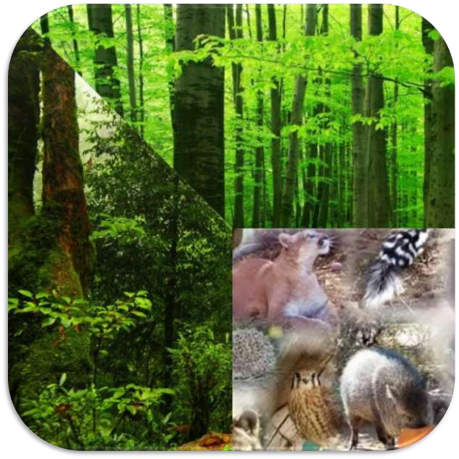


DON’T LET THEM BE A HISTORY!!

Slide 50

THANK YOU!!

